Slide 1




Create and share interactive content with H5P
Tami Belhadj
Techno-Pedagogical Consultant

Slide 2

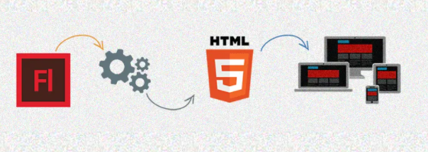
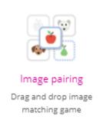

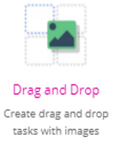



PRESENTATION OUTLINE
  Training modalities
    Leaning Management Systems
    Authoring tools
H5P
Over 40 Content types
Create and share interactive content
OER (Open Educational Resources)
  Open Educational Practices

Slide 3

CLASSROOM TRAINING
Attend a scheduled “class” in person and learn face-to-face.
ON PREMISE OFF PREMISE
Instructor led - Conferences
Peer-Coaching - Training LAB
Demonstrations - Seminars
Onboarding - Trade show
Tutoring
Note: Technology enhanced training with simulators and/or VR equipment can take place in a classroom.

Slide 4
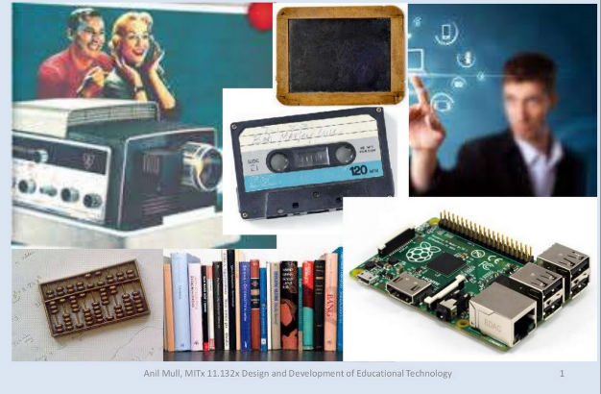
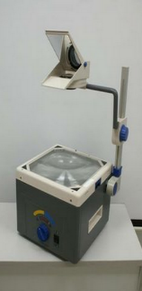
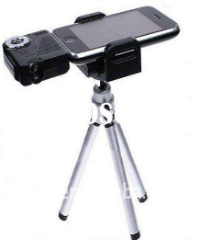
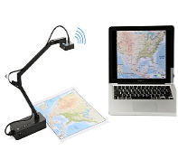
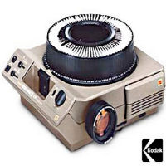


Classroom Technology

Slide 5
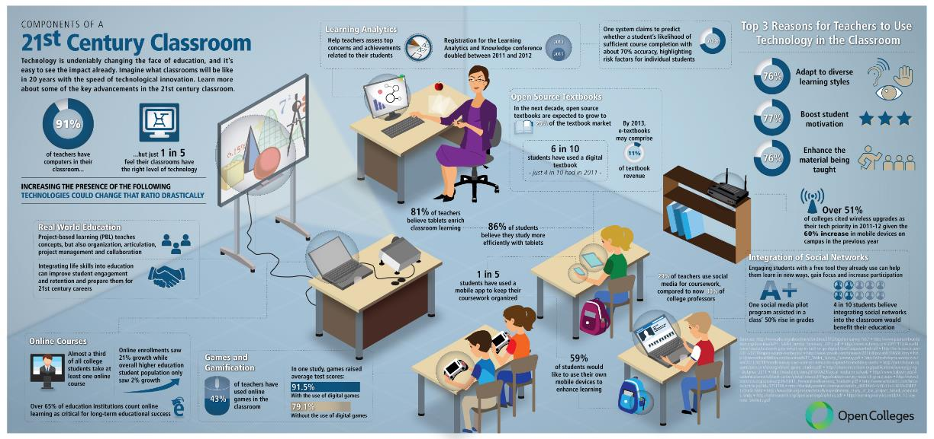
21st Century Classroom

Slide 6
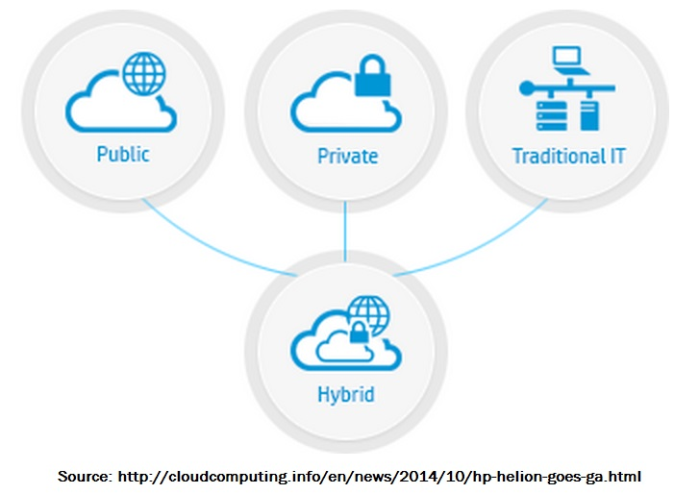


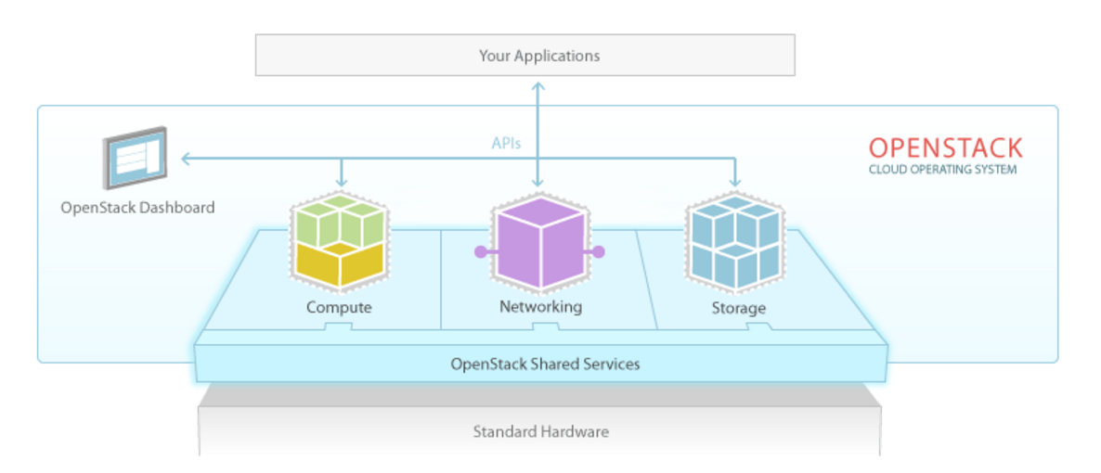

Cloud Computing
Source: www.openstack.org/software/

Slide 7
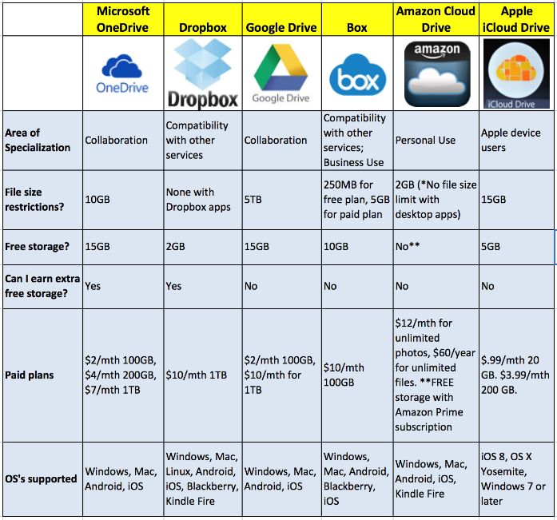





Source : https://blog.dlvrit.com/2015/04/google-vs-dropbox-cloud-storage/

Slide 8

E-LEARNING
Learning on your own using digital instructional material.
OFF LINE ON LINE
Mutlimedia on CD - Web based
Downloadable content - Asynchronous
Simulation software - Webinar
- Socialmedia enabled

Slide 9

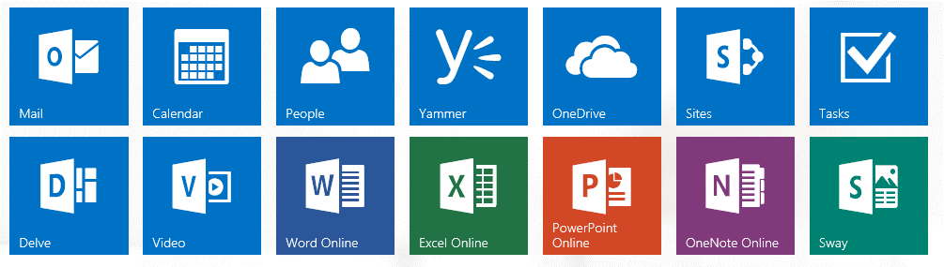

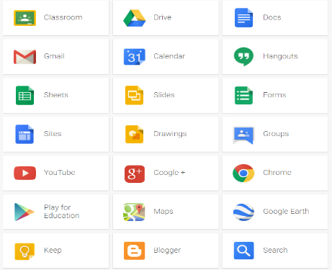

Slide 10

BLENDED LEARNING (Hybrid)
Benefit from courses that use a variety of delivery methods that include
Classroom training, E-learning and Virtual training.
ON/OFF PREMISE
ON LINE
VIRUTAL
COLLABORATIVE

Slide 11

VIRTUAL TRAINING
Attend an interactive, instructor-led class in real time via your internet-enable device.
ON LINE
- Web based
- Asynchronous
- Synchronous
- Audiovisual

Slide 12




TRAINING MODALITIES
CLASSROOM TRAINING
E-LEARNING
VIRTUAL TRAINING
BLENDED LEARNING
Administration
Flexible scheduling + Accommodating enrollment
Digital Content Repurposing + On line tutoring
Hardware + Software + Tech support
Leaning
Management
System
Andragogy
Technology
Notes:
Administration = HR + Training provider sales representative
Andragogy = Learner + Content specialist + Instructor
Technology = In-class technology ( didactical material + digital content )

Slide 13
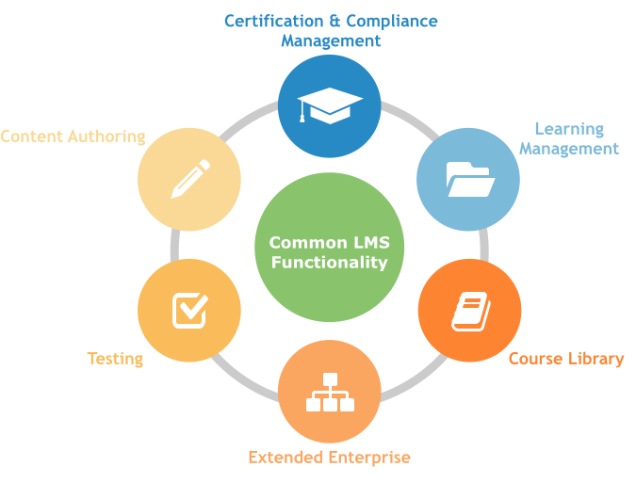


LMS functionality
http://www.atrixware.com/blog/wp/wp-content/uploads/2016/02/lms-flow.png
https://intervoke.com/learning-management-system-integration

Slide 14
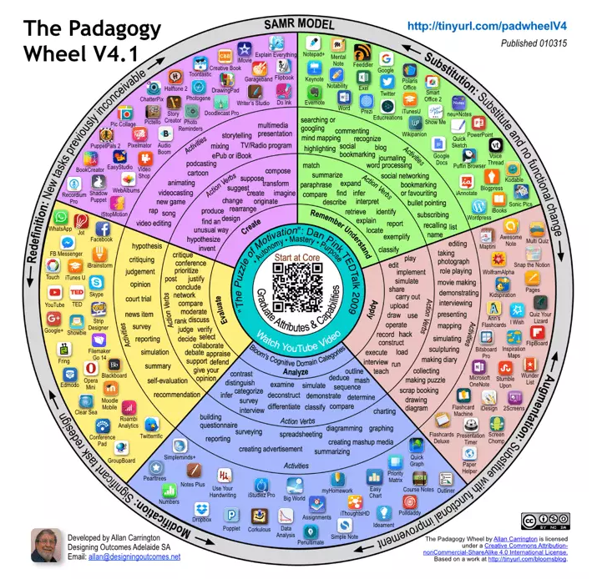







TOOLS AND IMPLEMENTATION OPTIONS
It’s Not About The Apps, It’s About The Pedagogy.
Alan Carrington
Notes:
Tools are critical for the implementation of synchronous and asynchronous teaching and learning situations.
However, it is important to have a sound pedagogical approach. Tools are here to support pedagogy not the other way around.

Slide 15


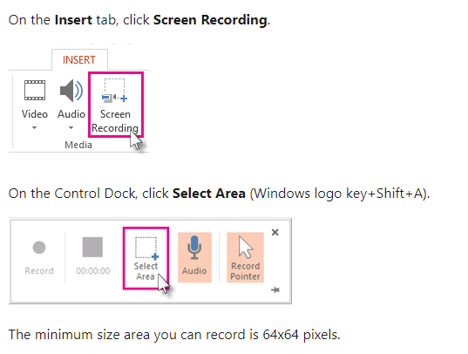
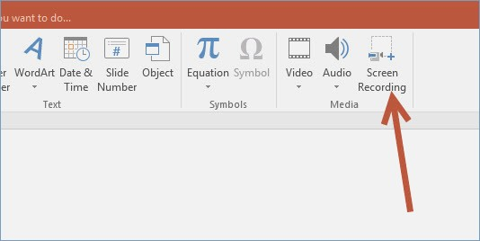
Power Point as visual support
Power Point for Screen Recording

Slide 16

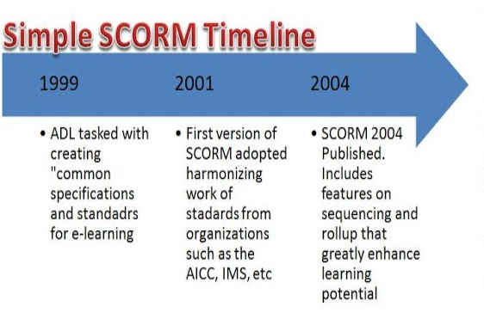

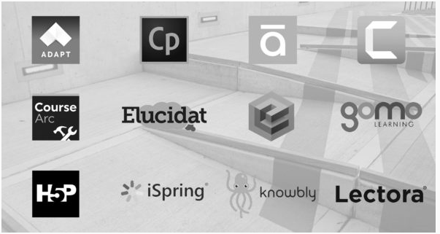
LMS interoperability
https://opensenselabs.com/blog/articles/scorm-and-e-learning-can-drupal-fit
Advanced Distributed Learning Initiative
https://adlnet.gov/
https://sites.google.com/site/instructionaldesignandtraining/scorm-and-section-508/scorm
https://www.elahub.net/what-should-elearning-authoring-tool-providers-be-telling-us-about-accessibility/

Slide 17


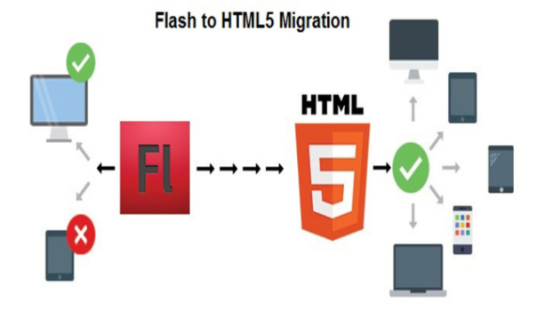

https://xatproject.com/swf/
Steve Jobs announced the death of Adobe Flash formerly called Macromedia Flash and Shockwave Flash in 2010.
https://kreatetechnologies.com/why-html5-over-flash/

Slide 18
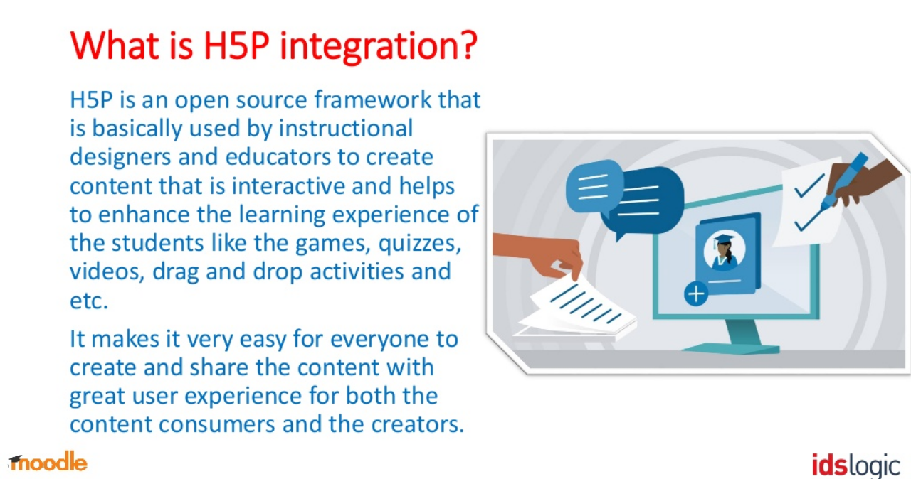
https://www.slideshare.net/idslogic65/h5p-is-integrated-in-moodle-38-getting-to-know-more

Slide 19
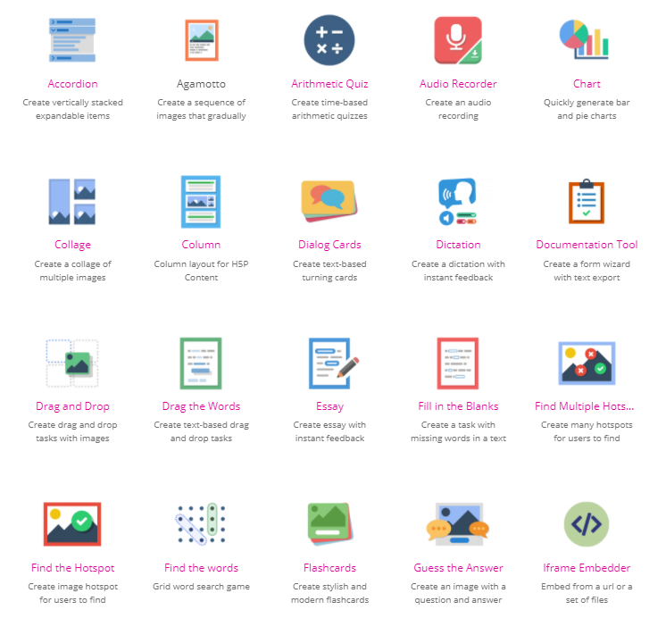
H5P Content Types
https://h5p.org/content-types-and-applications

Slide 20
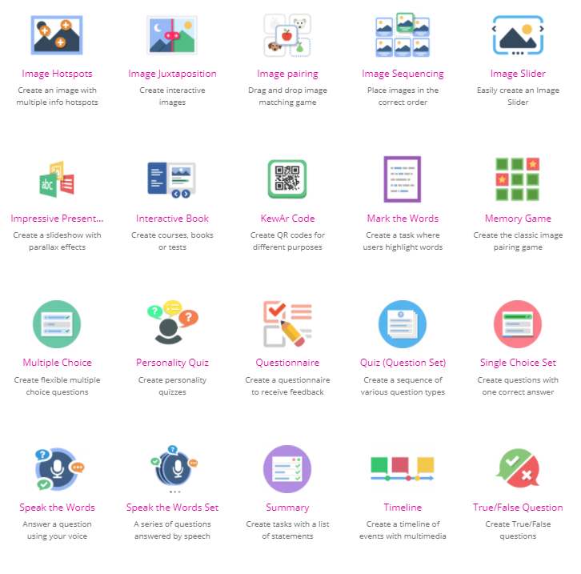
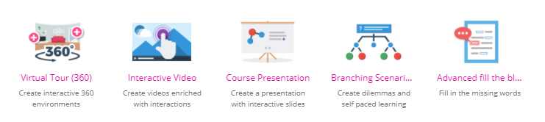
H5P Content Types
https://h5p.org/content-types-and-applications

Slide 21

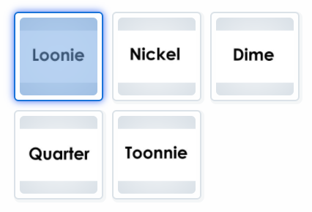
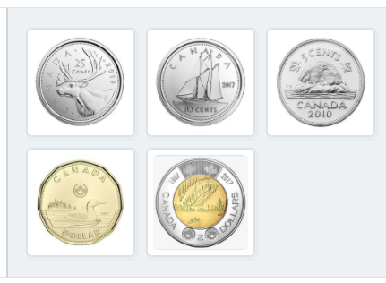
Image pairing
Enables teachers to create pairs of images to be matched. Learners are presented with the unpaired images and either use drag and drop, or click on the images that match.

Slide 22
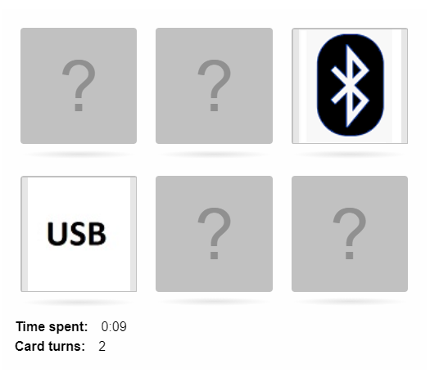
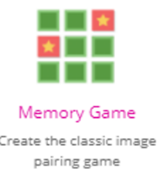
Memory game
Also known as Match Game, it can test the memory of learners in a fun way.
Techniques for training memory are discussed as far back as ancient Greece, and formal memory training was long considered an important part of basic education known as the art of memory.

Slide 23
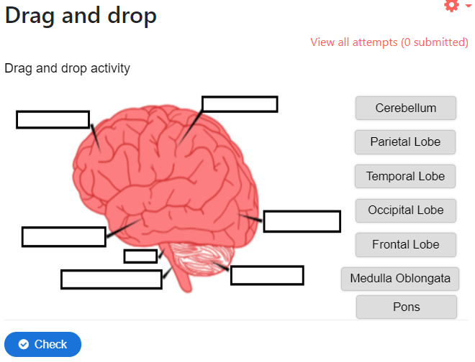

Drag and drop
Drag and drop questions enable the learner to associate two or more elements and to make logical connections in a visual way. Create Drag and drop questions using both text and images as draggable alternatives. H5P Drag and drop questions support multiple draggable to drop zone combinations; one-to-one, one-to-many, many-to-one and many-to-many.

Slide 24
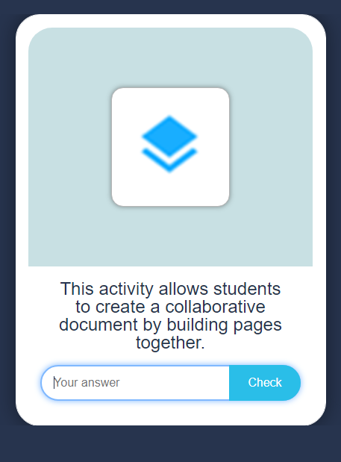


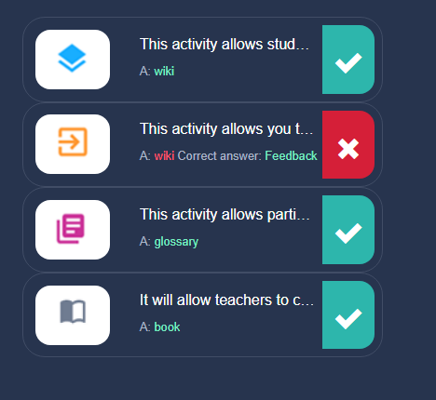
Flash card
Enables teachers to create a single flash card or a set of flashcards that have both questions and answers. Learners are required to fill in the text field, and then check their solution.

Slide 25
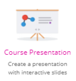
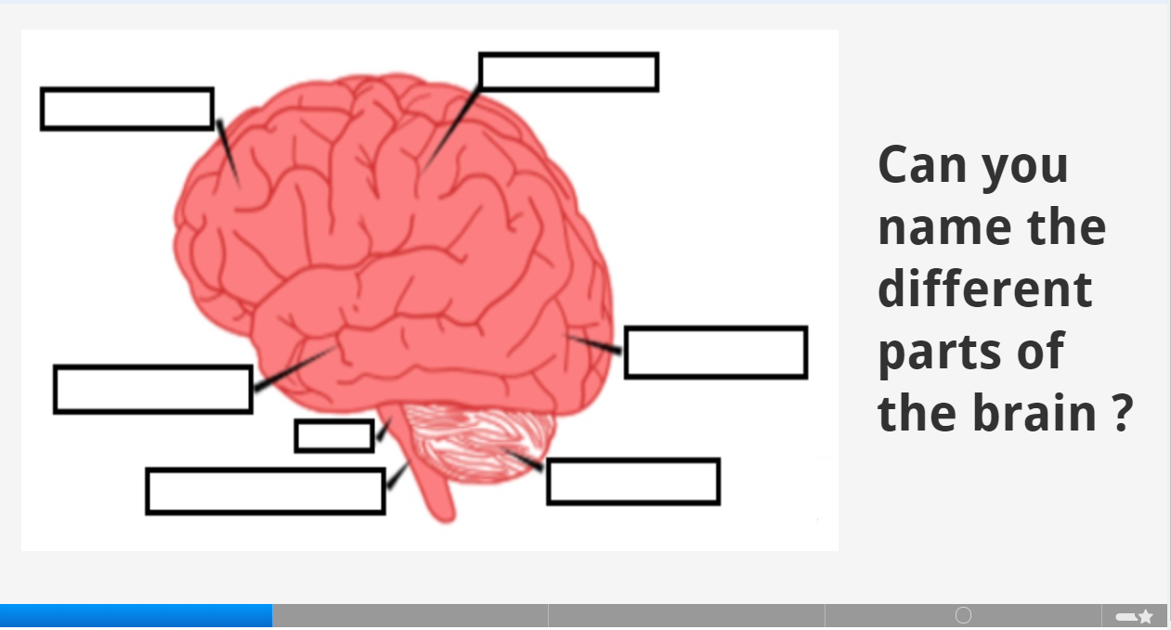

Presentation
Course Presentations consist of slides with multimedia, text, and many different types of interactions such as interactive summaries, multiple choice questions, and interactive videos.
https://h5p.org/h5p/embed/1045423

Slide 26
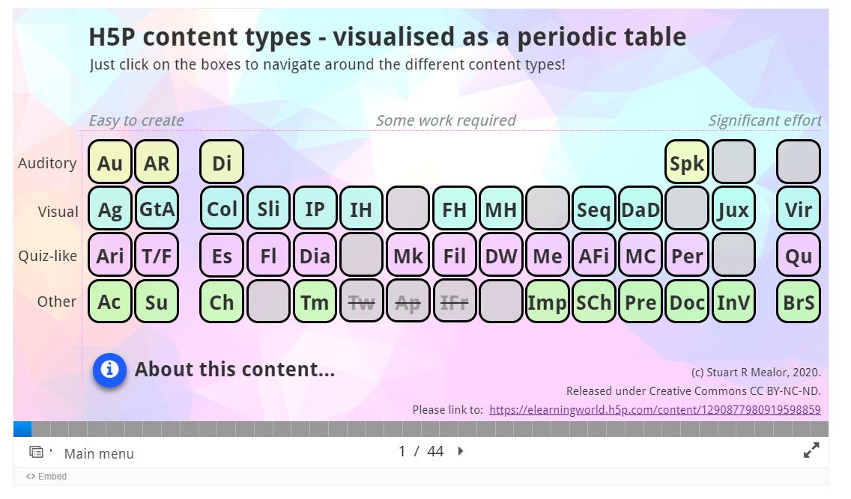
Image Pairing
Drag and Drop
Flashcards
Memory Game
Presentation
https://elearningworld.h5p.com/content/1290877980919598859

Slide 27
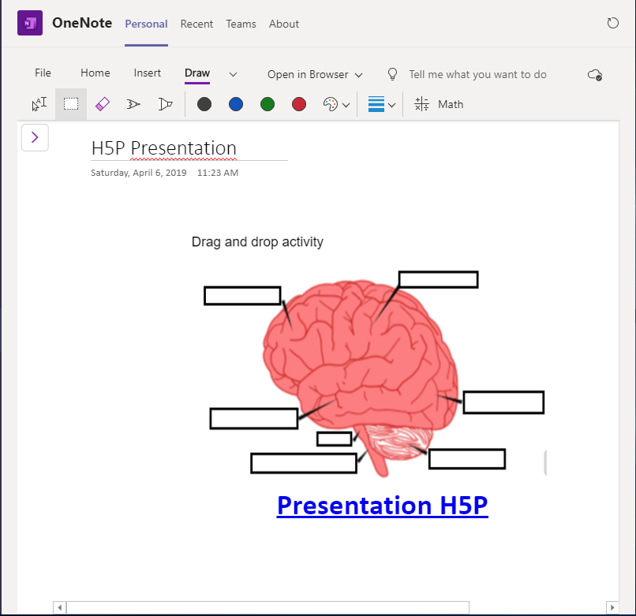



Creating and Sharing interactive content in H5P
MicroSoft - OneNote
H5P.ORG

Slide 28

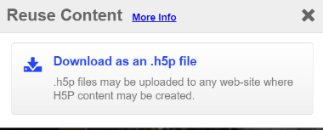




LMS integration
H5P.ORG
Plugin
Content
Bank
https://h5p.org/oer-hub-coming

Slide 29
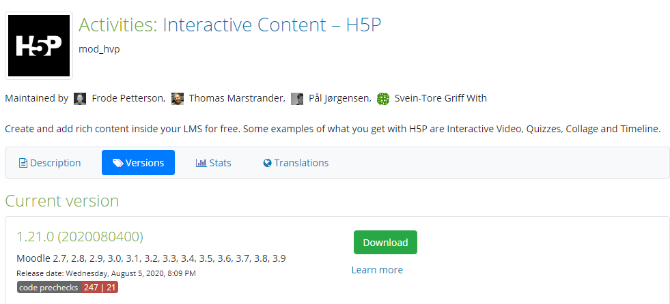


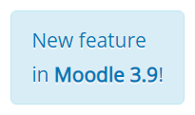

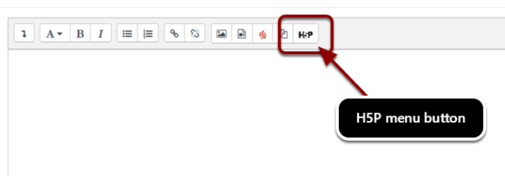
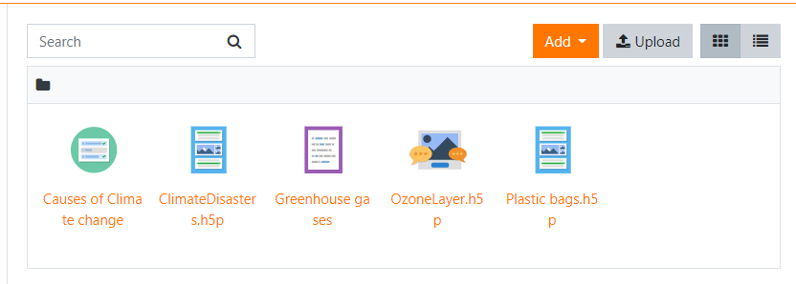

Slide 30

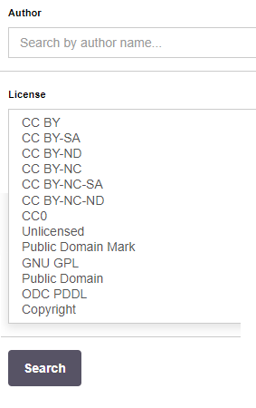
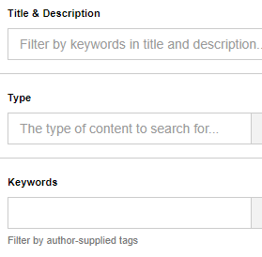

https://h5pstudio.ecampusontario.ca

Slide 31
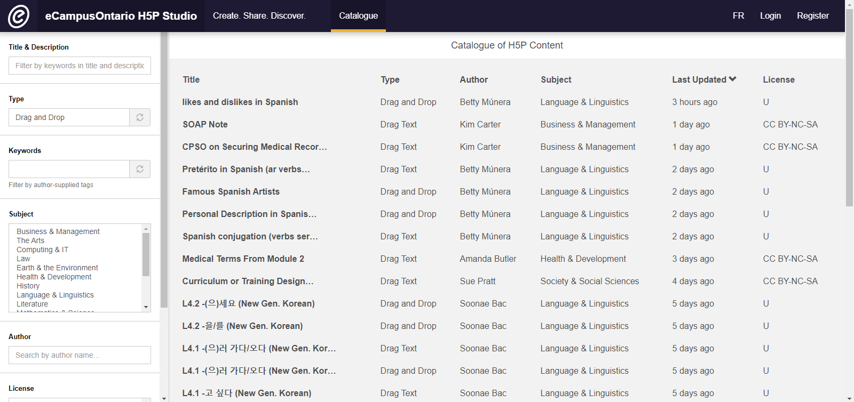

Slide 32
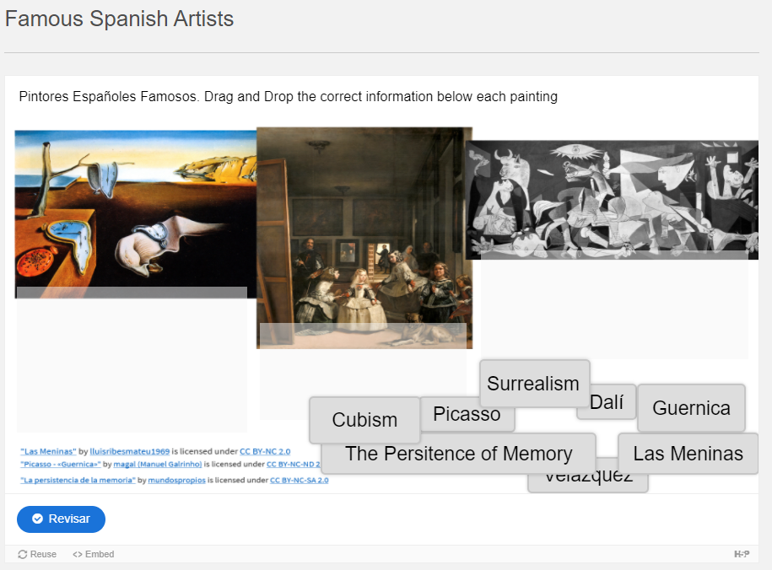
https://h5pstudio.ecampusontario.ca/content/11089

Slide 33

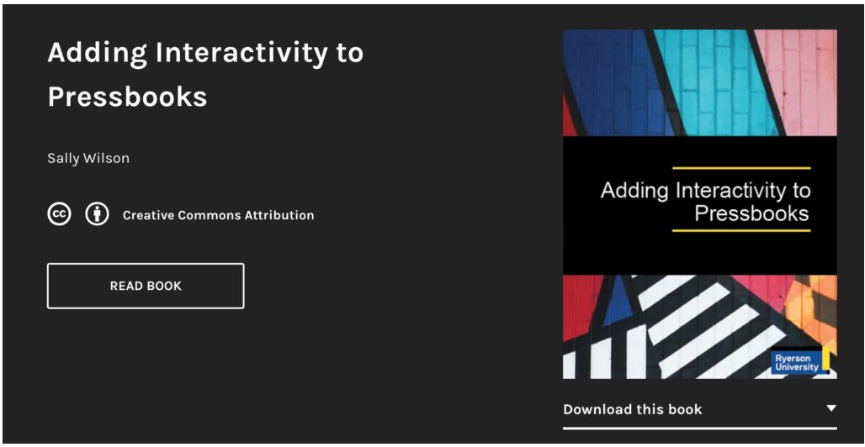



Slide 34
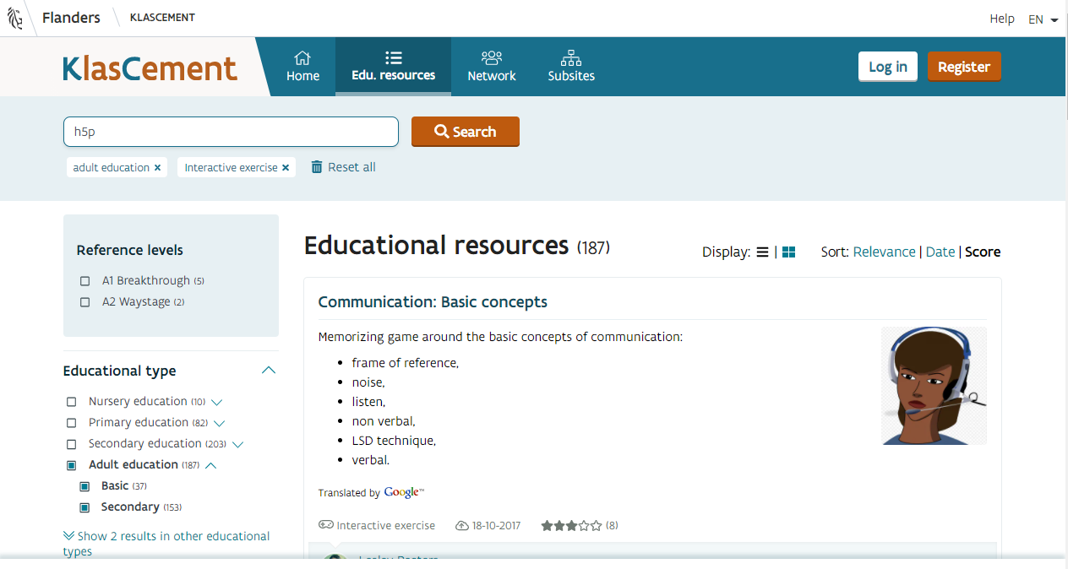
https://www.klascement.net/

Slide 35
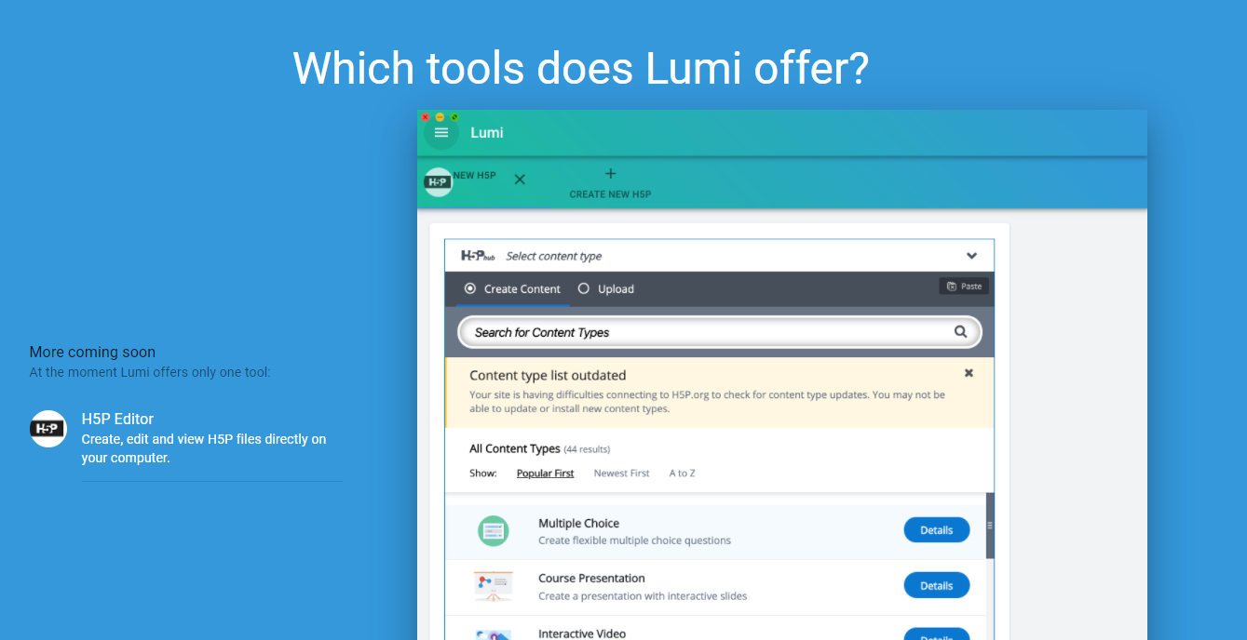
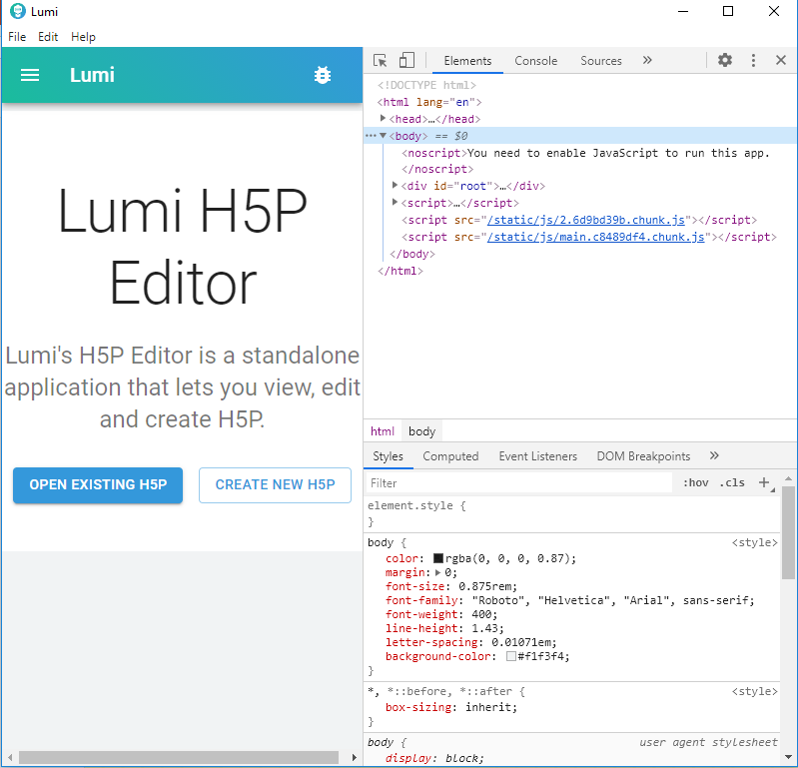
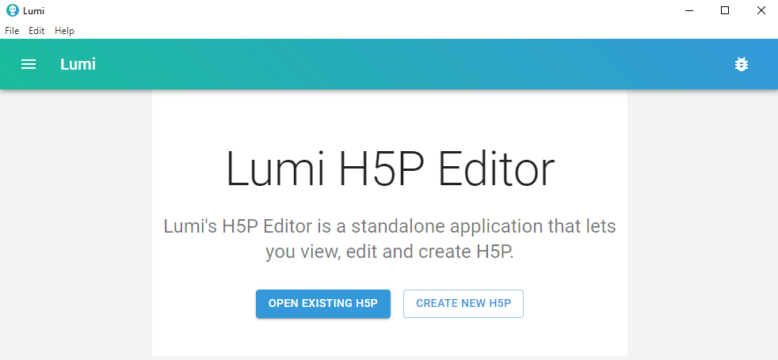

http://lumi.education/

Slide 36






@H5PCom
https://h5p.org/oer-hub-coming

Slide 37
Q&A

Slide 38


Tami Belhadj
Techno-Pedagogical Consultant
tami.belhadj@gmail.com

